Slide 1
Committee Meeting
Qinwen Xia
2017-10-16

Slide 2
Updates
Classes + Research + Writing

Slide 3
Updates-Classes
Course Title | Grade (GPA 3.84)
Stat Meth Research 1 | A
Insect Neuro-ethology | B
Evolution | A
Field Techniques | B+
Grad Survey Biochem | A
Res Design Wildl Ecol | A
Insect Physiology | A
Insect Physiology Lab | A
Intro Public Speaking | A-
Intro To Applied Stat | A-
Insect Chemical Ecol | A

Slide 4
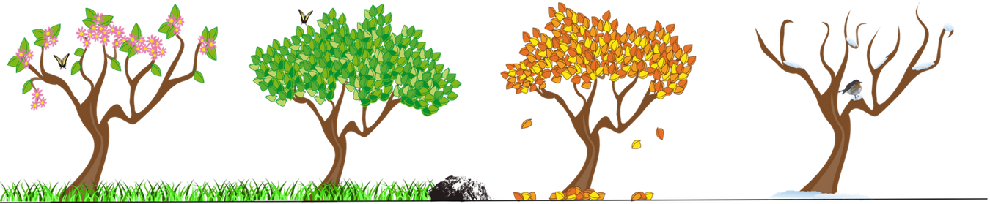


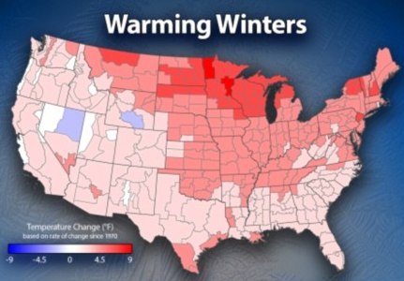
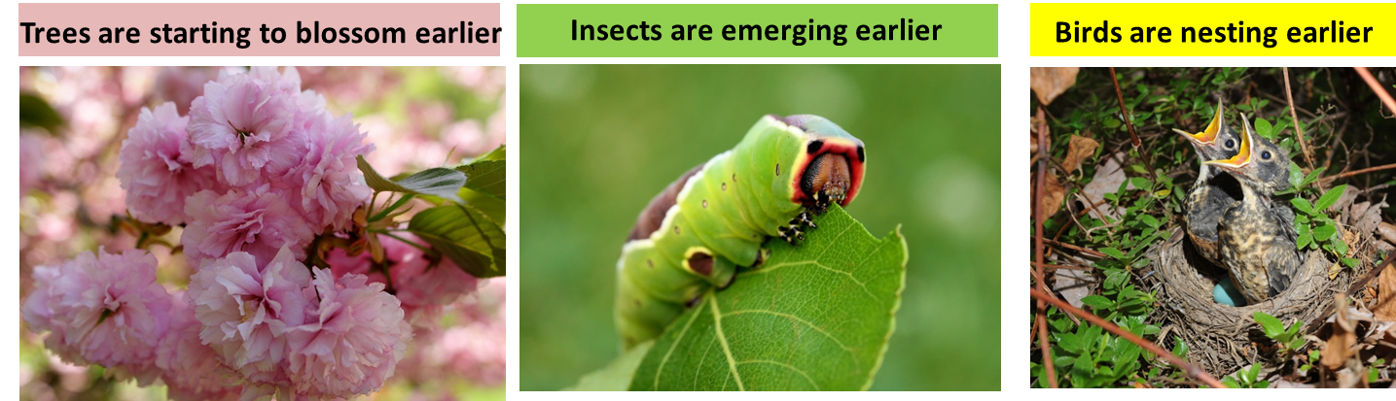
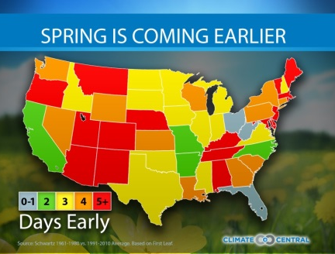
Project Refresh
Life cycle timing
Seasonality
Climate Change
Shifts in the Phenology

Slide 5
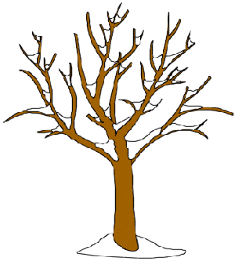

Project Refresh
Diapause: A trait sets synchrony
Endocrinal basis underlying the rapid evolution of life cycle timing
The release timing of hormone
The titers of hormone
The sensitivity of tissues to hormone
Upstream events of hormone regulation

Slide 6
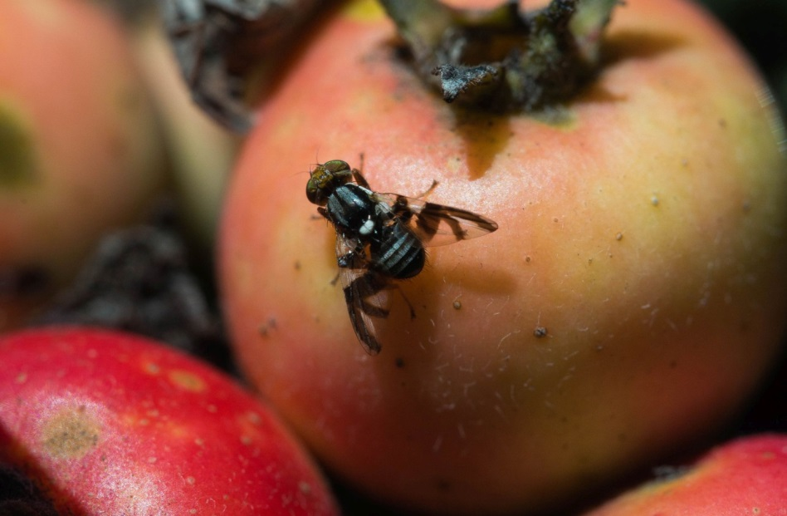
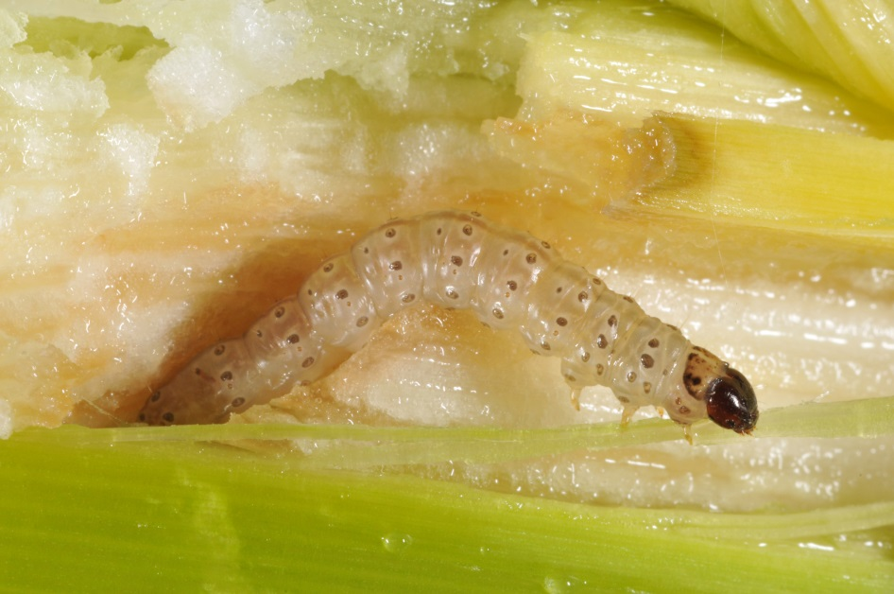
Updates-Study System
Apple maggot Rhagoletis pomonella
European corn borer Ostrinia nubilalis

Slide 7


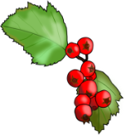

Refresh-Rhagoletis pomonella
The divergence of life cycle timing between two host races arises by pupal diapause
% Total flies emerged
% Fruits mature
Apple
Hawthorn
JUNE
JULY
AUG
SEPT
OCT
NOV
Pupal diapause is characterized by a suppression of ecdysteroid synthesis;
Diapause termination is triggered by release of ecdysteroids.

Slide 8
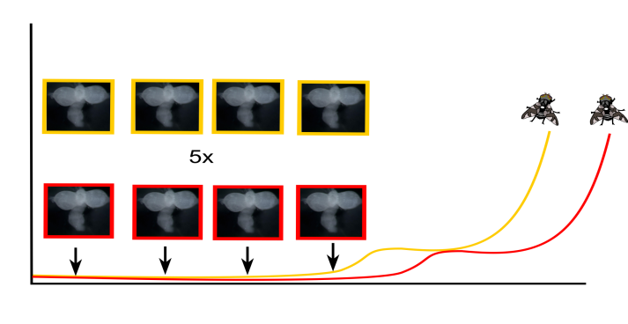

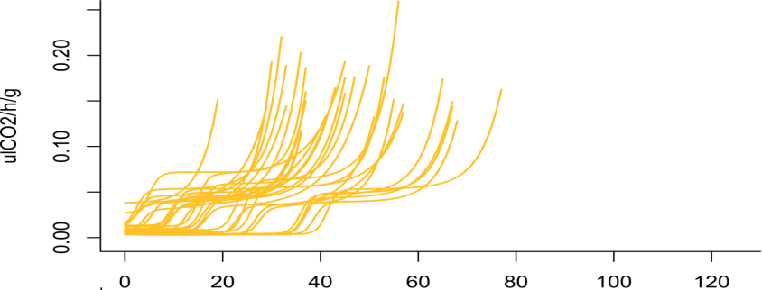


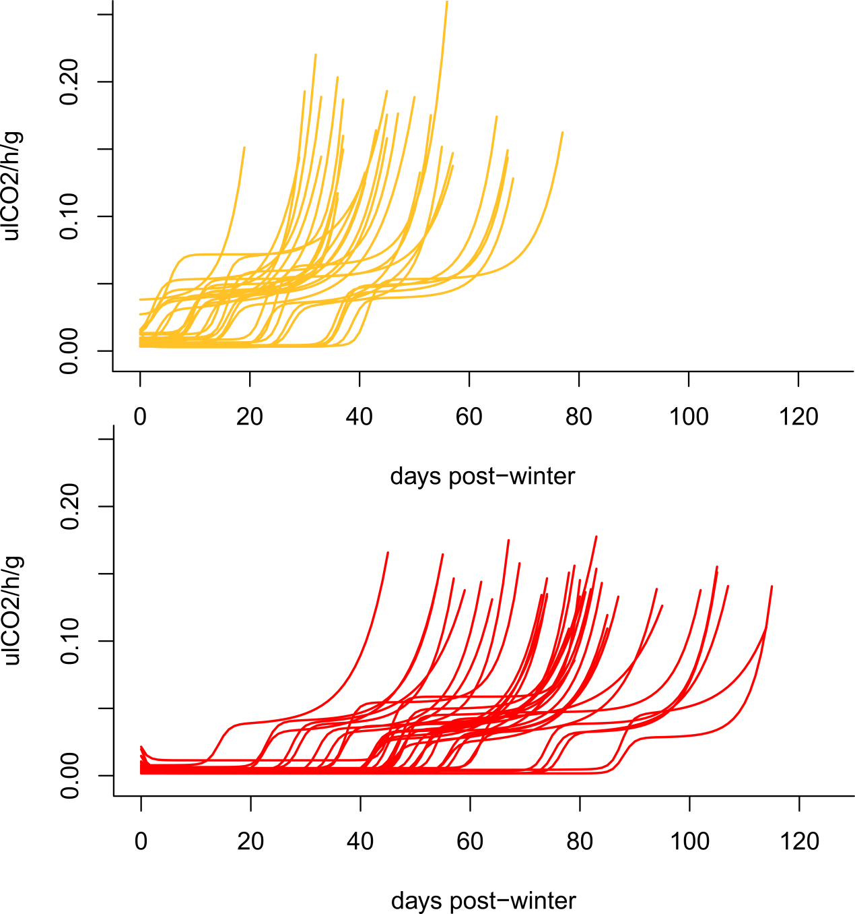
Objective and Hypothesis
Days post winter
Days post winter
OBJECTIVE
To compare the release timing and titers of ecdysteroids, and sensitivity to ecdysteroids between apple and hawthorn race across diapause stage.
HYPOTHESIS
EARLIER PUPAL
DIAPAUSE
TERMINATION
EARLIER ECDYSTEROIDS
RELEASE
EARLIER SENSITIVE STAGE
TO ECDYSTEROIDS
And/or

Slide 9
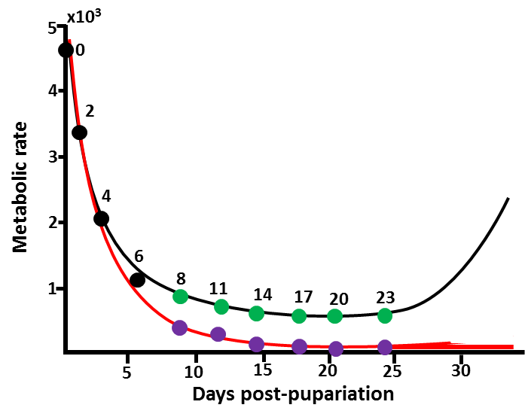
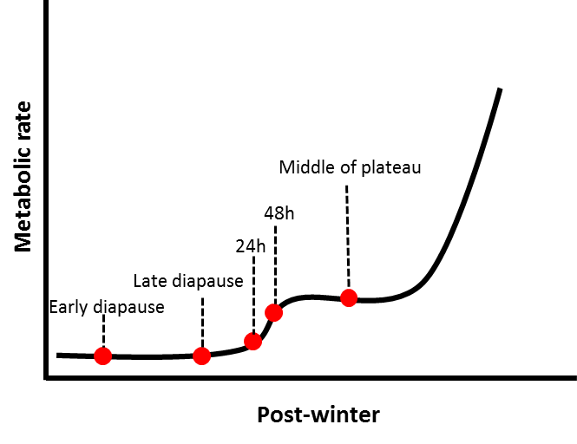
Experimental Design
pre-winter
over-winter
post-winter
8, 12, 16, 20 weeks
at 4°C
pre-winter
10 days after pupariation
over-winter
12, 16, 20 weeks after at 4°C
Week 1, 2, 3 after transferring
to 24°C from 4°C
post-winter

Slide 10
Result-Ecdysteroid_ND vs. D

Slide 11
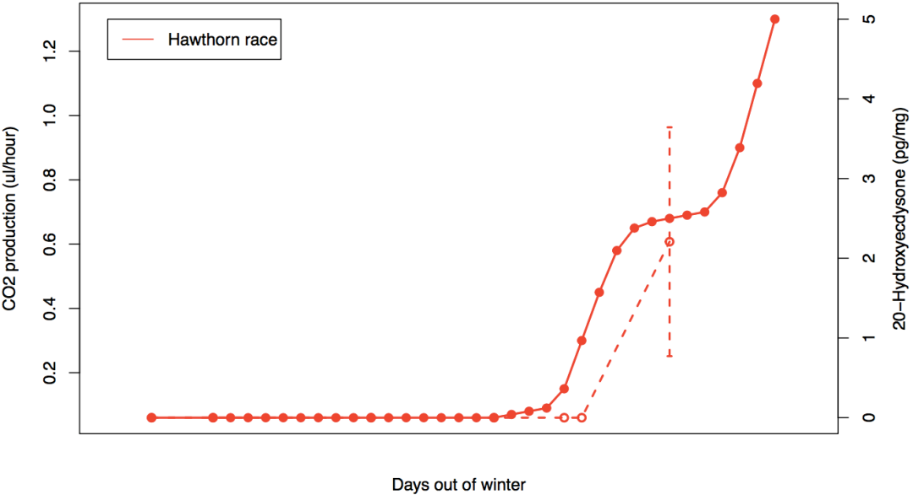
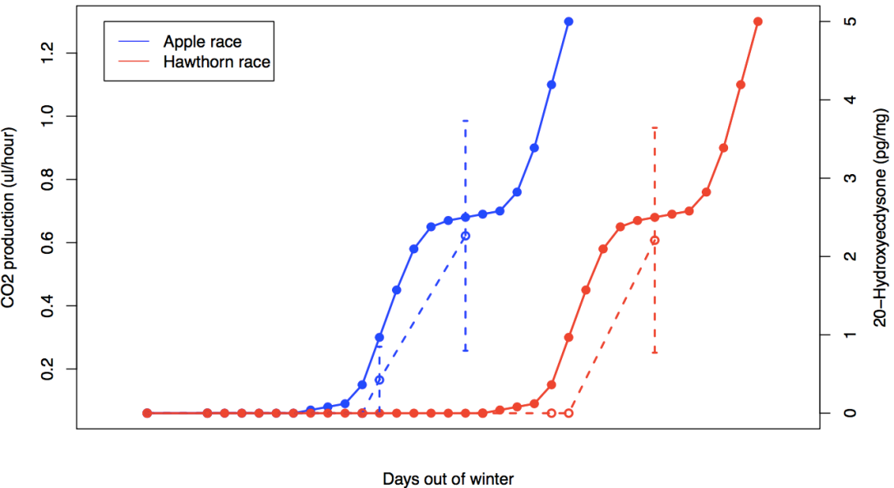
Result- Ecdysteroid_Postwinter
P
48h
ED
LD
24h
P
P
48h
48h
ED
LD
24h
24h

Slide 12
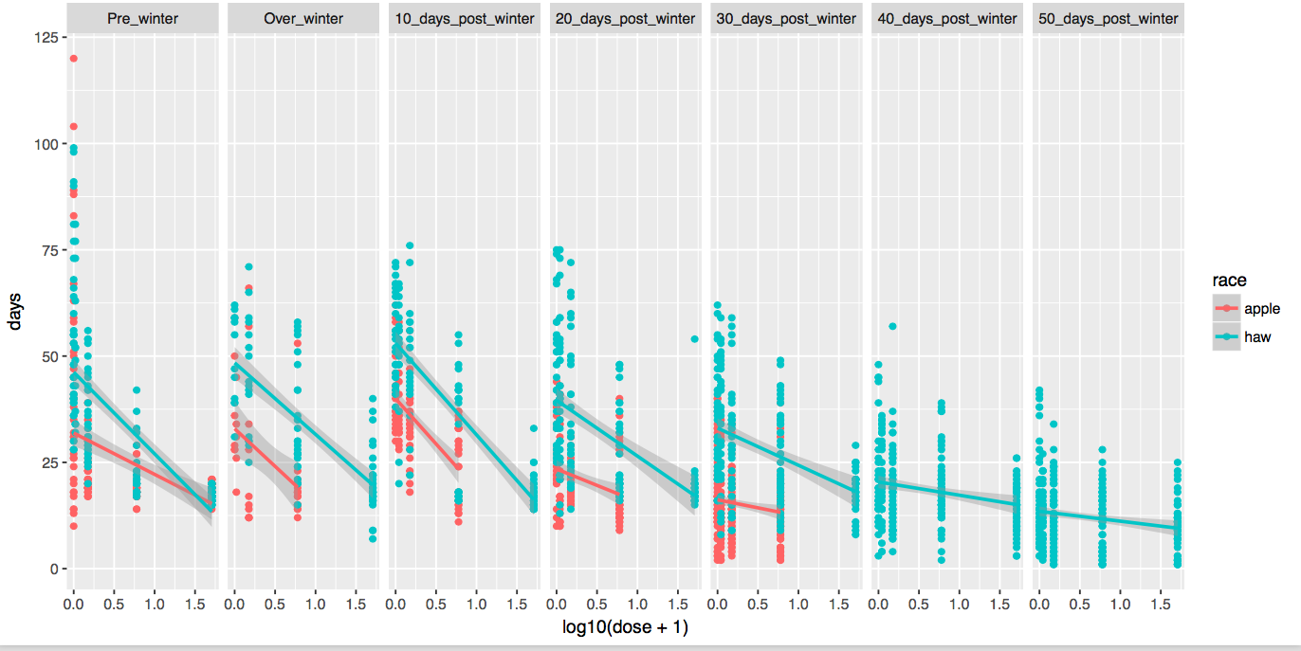
Result-Ecdysteroid Sensitivity

Slide 13
Summary-Chapter1

Slide 14
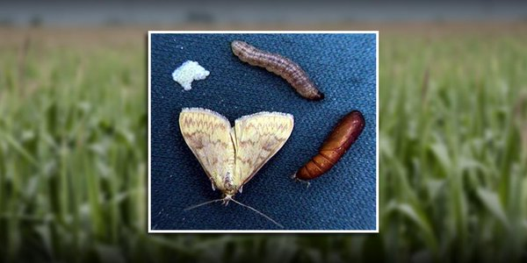

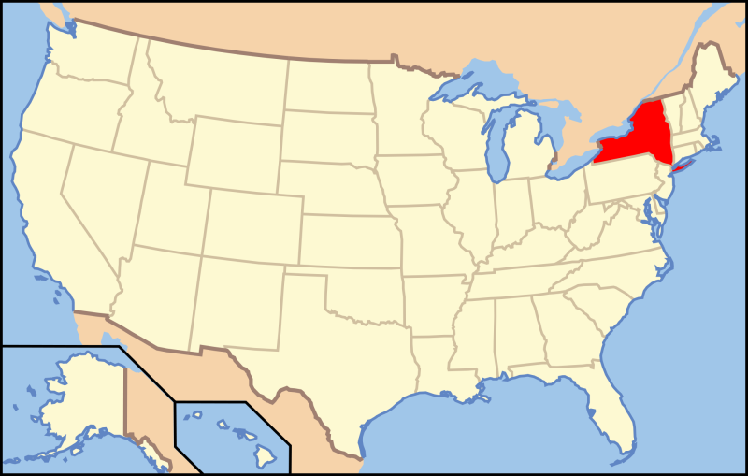
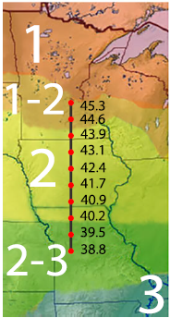
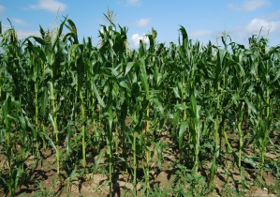
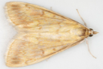
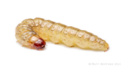
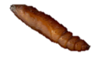

European corn borer
Life cycle
Latitudinal variation in voltinism
Diapause as
a last instar
larva
Two ecotypes with different sex pheromone
Sympatric bivoltine E strain and univoltine Z strain
(E)- and (Z)-11-tetradecenyl acetates
BE strain
UZ strain
Z strain
1:99
E strain
98:2
Breeding Adults
JUNE
JULY
AUGUST

Slide 15
Post Diapause Duration
30
BE strain
23
UZ strain
Pupae
15
8
0
7
21
35
49
63
Day
What are physiological mechanisms underlying the evolutionary
changes in life history timing?
Notes:
Bivoltine migration
into univoltine areas, and minimal gene flow due to non-overlapping
mating periods, may have maintained ecotype differences.

Slide 16

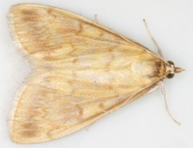
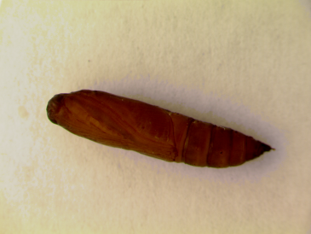



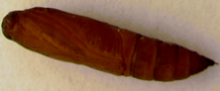
Hormonal regulation
Prothoracic Gland
(PG)
Insect molting hormones
Ecdysteroids
Adult
Larval diapause is characterized by a suppression of ecdysteroid synthesis;
Larval diapause termination is triggered by synthesis of ecdysteroids.
(Denlinger et al. 2011)

Slide 17
Objective and Hypothesis
30
BE strain
23
UZ strain
Pupae
15
8
0
7
21
35
49
63
Day
OBJECTIVE
To compare the release timing and titers of ecdysteroids, and sensitivity to ecdysteroids between UZ and BE strains across diapause stage.
HYPOTHESIS
EARLIER LARVAL
DIAPAUSE
TERMINATION
EARLIER ECDYSTEROIDS
RELEASE
EARLIER SENSITIVE STAGE
TO ECDYSTEROIDS
And/or

Slide 18
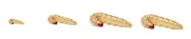
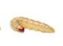
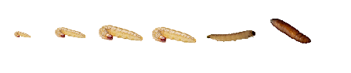
Experimental design
1. A comparison of ecdysteroid titers between diapause and non-diapause destined fifth instar
larvae.
Diapause:
23℃, LD 12:12
Non-diapause:
23℃, LD 16:8
1 | 2 | 3 | 4 | 5 | 6 | 7 | 8 | 9 | 10 | 11
Days after 5th instar
2. A comparison of ecdysteroid titers between BE and UZ strains after being transferred
into diapause termination condition.
46 days after being in 23℃, LD 12:12
Diapause termination: 26℃, LD 16:8
BE
1 | 5 | 9 | 13 | 17 | 21
UZ
1 | 5 | 9 | 13 | 17 | 21 | 25 | 29 | 33 | 37 | 41 | 45 | 49 | 53 | 57 | 61 | 65
Days after transfer into diapause termination condition

Slide 19
Result

Slide 20

Objective and Hypothesis
30
BE strain
23
UZ strain
Pupae
15
8
0
7
21
35
49
63
Day
OBJECTIVE
To compare the release timing and titers of ecdysteroids, and sensitivity to ecdysteroids between UZ and BE strains across diapause stage.
HYPOTHESIS
EARLIER LARVAL
DIAPAUSE
TERMINATION
EARLIER ECDYSTEROIDS
RELEASE
EARLIER SENSITIVE STAGE
TO ECDYSTEROIDS
And/or

Slide 22


Experimental Design
Hypothesis : BE strain becomes sensitive to exogenous ecdysteroids earlier
than UZ strain, which corresponds to an earlier termination of BE
strain in summer than UZ strain
20-hydroxyecdysone
Injection plan:
BE
0 | 1 week | 2 weeks
UZ
0 | 1 week | 2 weeks | 3 weeks | 4 weeks | 5 weeks | 6 weeks | 7 weeks

Slide 23
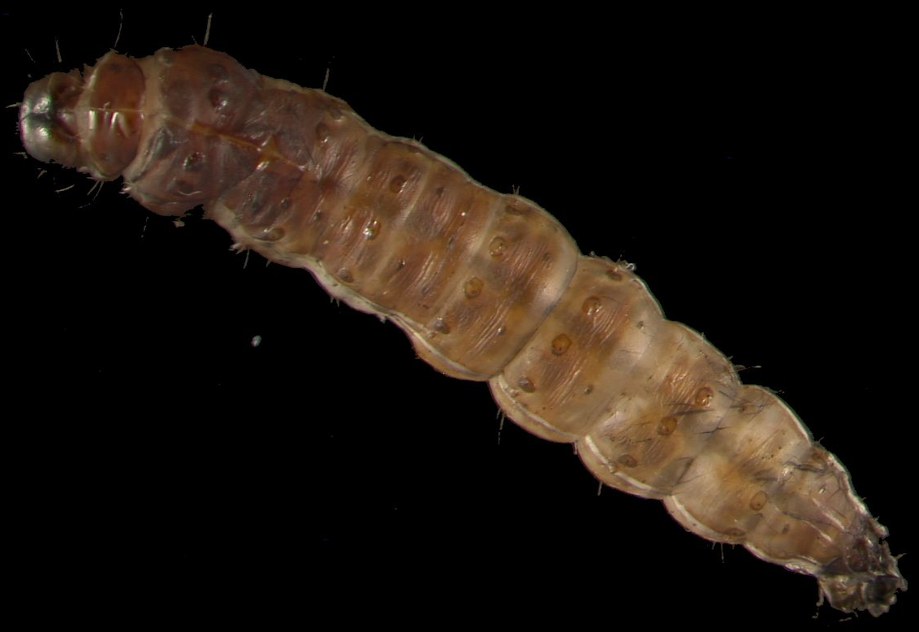
Result

Slide 24
Summary –Chapter2

